Slide 1
ideaTI n
Presented By:
Ed Wolf
@DigitalDuckTape

Slide 2
Perspective
Within five years, 70 percent of collaboration and communications applications designed on PCs will be modeled after user experience lessons from smartphone collaboration applications.
By 2014, social networking services will replace e-mail as the primary vehicle for interpersonal communications for 20 percent of business users.
Through 2015, only 25 percent of enterprises will routinely utilize social network analysis to improve performance and productivity.
Gartner Group

Slide 3
The Social Web
We are more connected. People, not organizations, control the new mediums of communication.

Slide 4
Approaches to Ideation
Open Ideation: Submit any idea, anytime
Campaigns: topic focused and time limited
Process Driven: Integrated with the product or service development lifecycle

Slide 5
Typical Ideation Process

Slide 6
Expanding Idea Generation
Internal Stakeholders
Online Customer Communities
Marketing, Sales,
Support, etc
Partners & Vendors
Consumer Social Networks
?

Slide 7
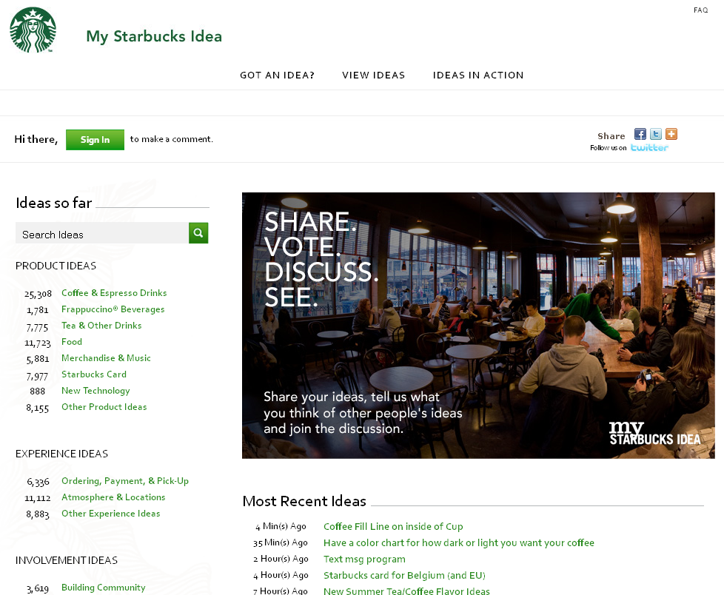
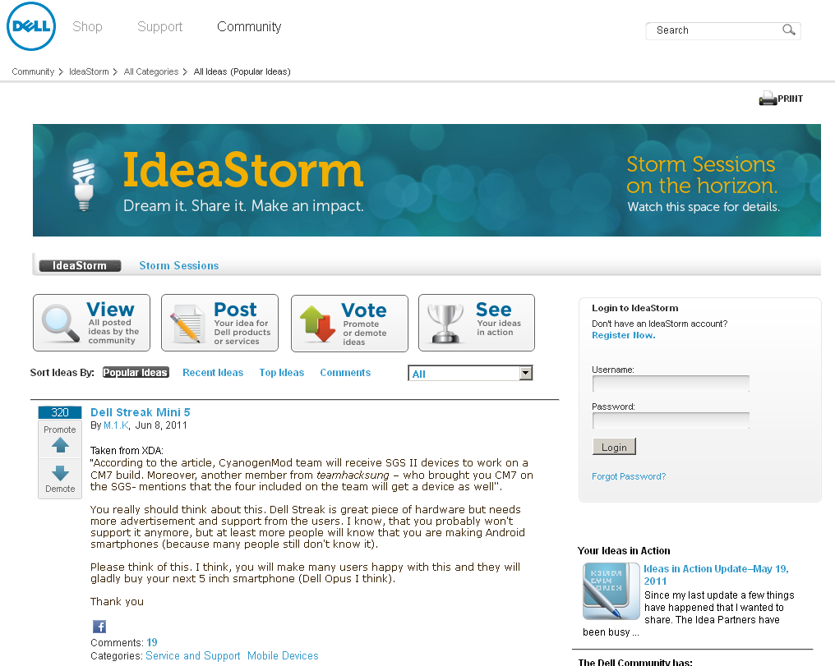
My StarBucks Idea
63,000 Product ideas
25,000 Experience ideas
15,000 Involvement ideas
Dell Ideastorm
15,736 ideas contributed
442 ideas implemented

Slide 8
Short-Term Benefits of Ideation
Discover/invent new, distinguishable and potentially sustainable solutions for our customers.
Discover/invent unrecognized or new customer needs.
Spread and confirm ideas generated elsewhere.
Generate enthusiasm -> buy-in -> ownership of new ideas.

Slide 9
Long-Term Benefits of Ideation
Enhance networking among employees.
Establish a decentralized idea community.
Improve employee satisfaction:
Involvement (having an impact on the Big Picture),
Security (focus beyond current problems).
Get low-value ideas off the list once-and-for-all!

Slide 10
10 Tips For Creating The Right Culture
Tear down the walls or create dedicated ideation space
Provide a framework to capture ideas
Create a positive environment to delivery pitches
Create and maintain your idea inventory and review it regularly
Be accessible
Establish rules of engagement
Make it easy for customers to provide and track feedback
Be clear about who owns the idea
Recognize and reward contributors
Encourage the creative process

Slide 11
Vendor Research Approach
Utilize Gartner to identify industry leaders and best practices
Invite companies to demo their product
Evaluate each product on:
Functionality
Compatibility (SSO, Mac, SharePoint)
Price
Company History & Clientele

Slide 12
Product Rankings
Inova
Spigit
Induct
Kindling
Elguji
InnoCentive
Idea Submission
Idea Submission
Idea Submission
Idea Evaluation
Project Management
Idea Submission
Idea Submission
Idea Submission
Idea Evaluation
Idea Submission
MindMatters
Idea Evaluation
Idea Submission
BrainBank
Idea Evaluation
Idea Submission
Imaginatik
Idea Evaluation
Idea Submission
Hype
Project Management
Idea Evaluation
Idea Submission
Brightidea
Ranking Criteria:
Price
Features
UI & UX
Underlying Technology
Rollout time
Clientele

Slide 13
Possible Next Steps
Get buy-in and support from:
Executive leadership
Legal & HR
Build a marketing plan to promote internally
Begin a small pilot
Roll out to the rest of the company once all processes are established and refined

Slide 14
Final Thought
Success in social software and collaboration will be characterized by a concerted and collaborative effort between IT and the business.
Gartner Group

